Slide 1
Club and Community Development
New England Nordic Ski Association

Slide 2
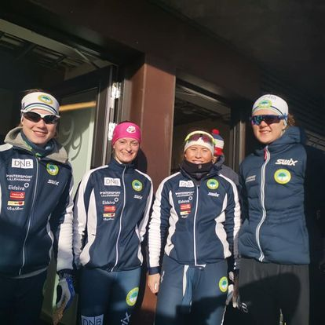
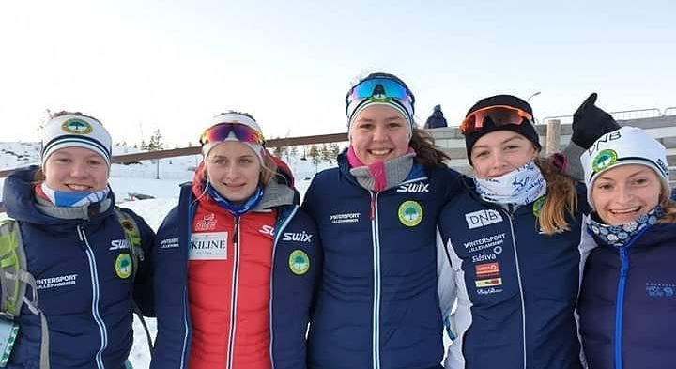
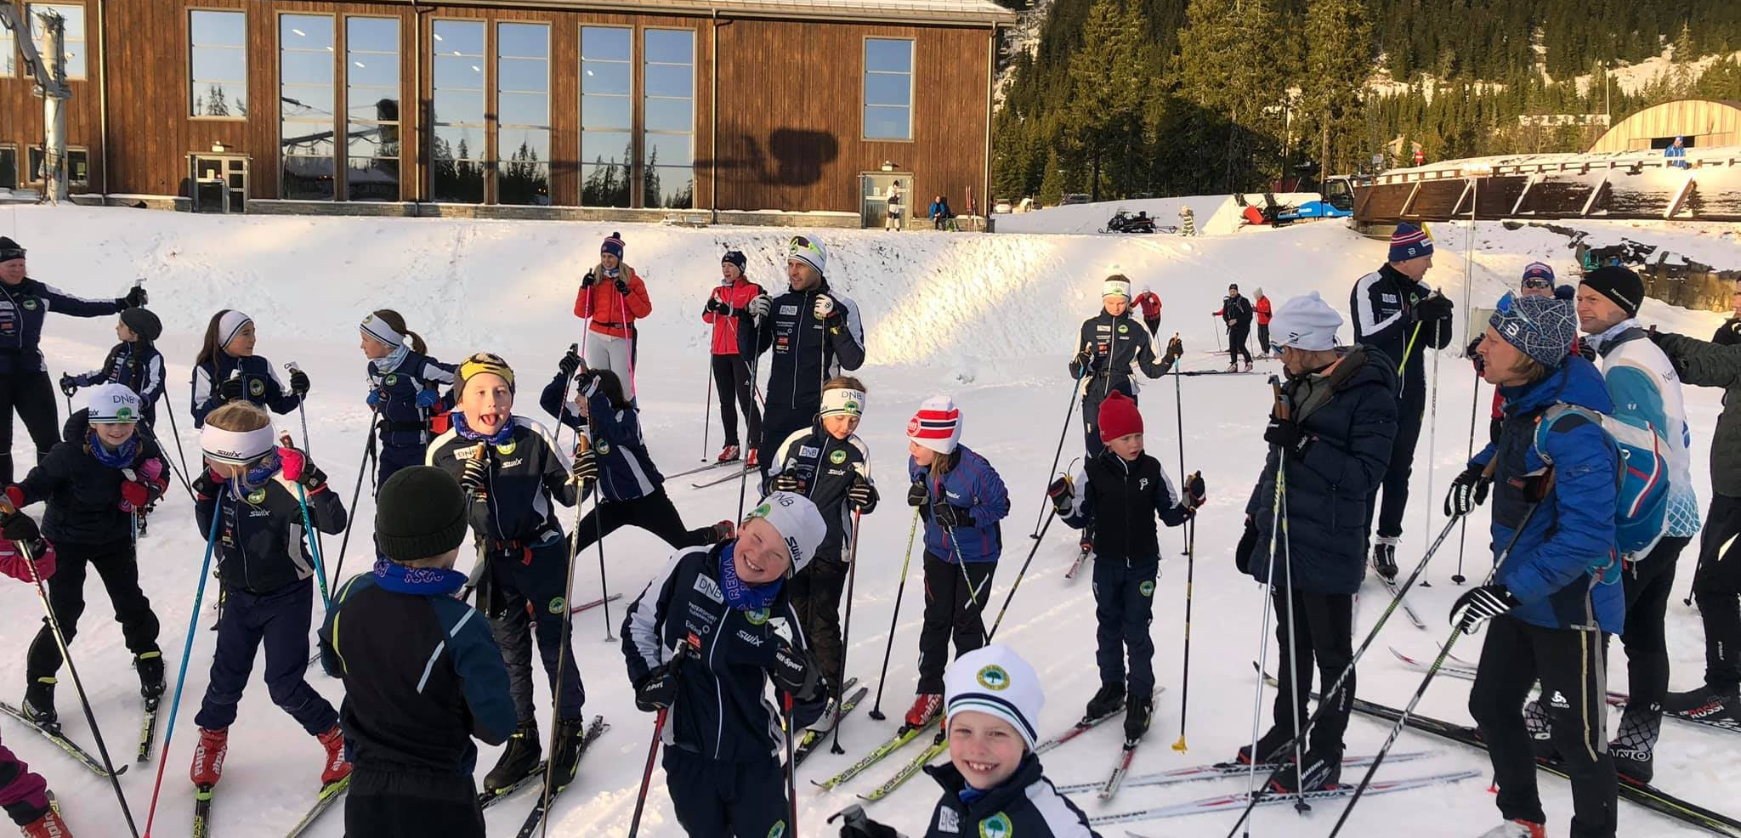

Slide 3
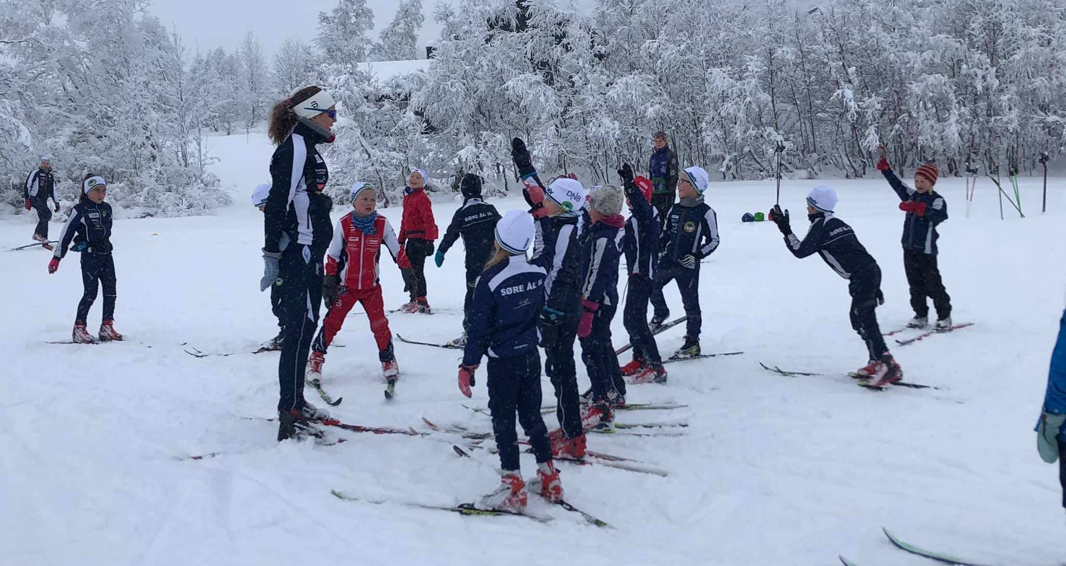
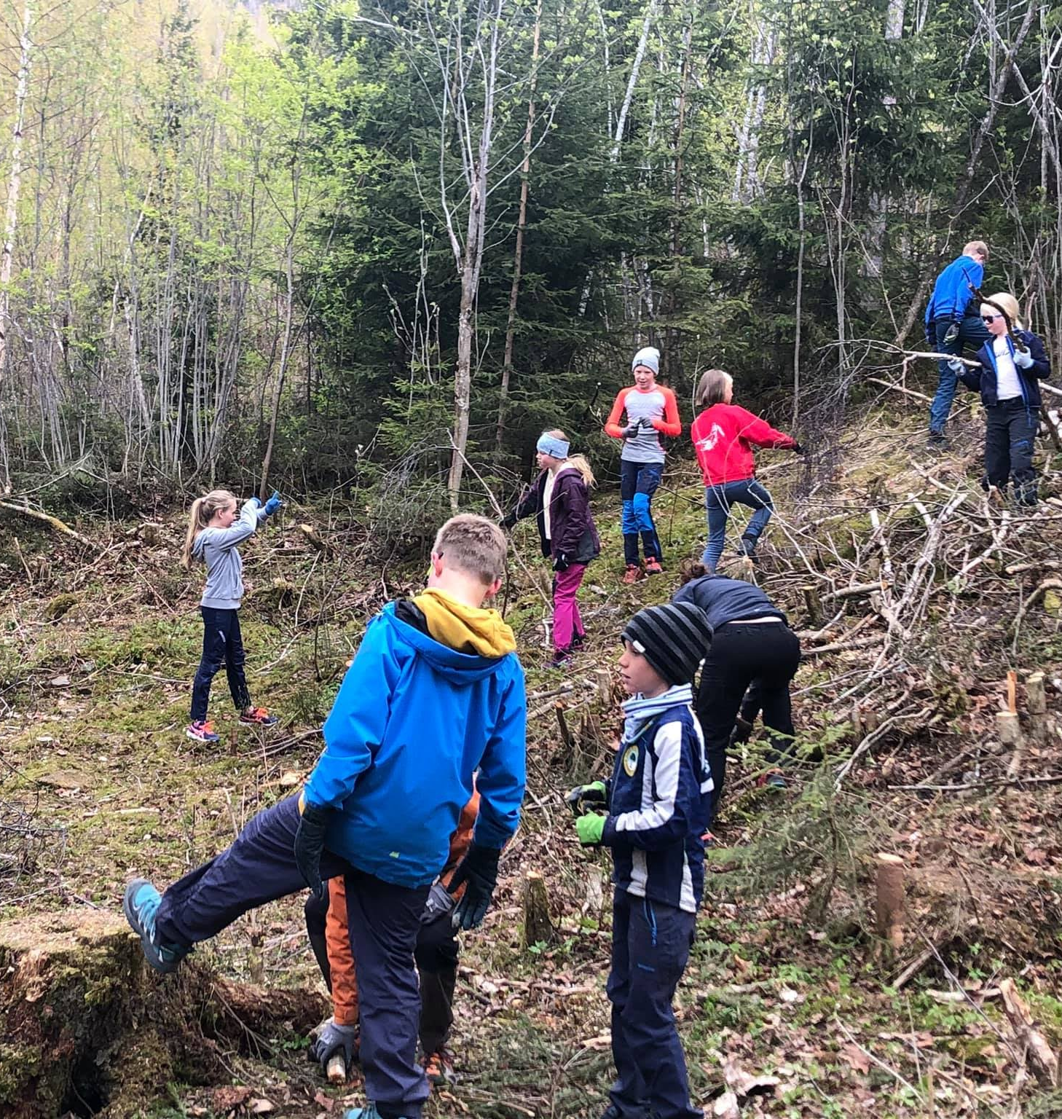
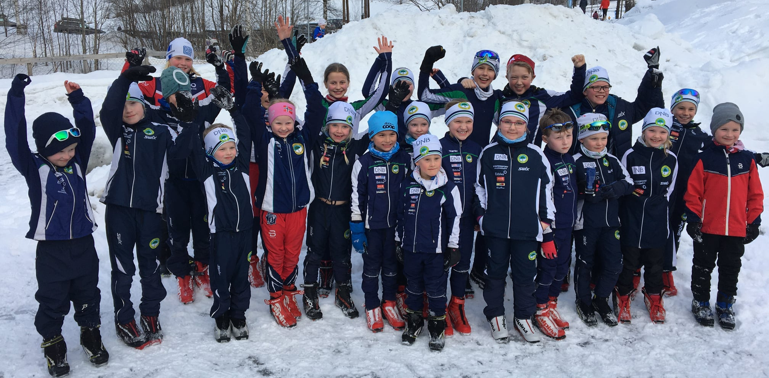

Slide 4
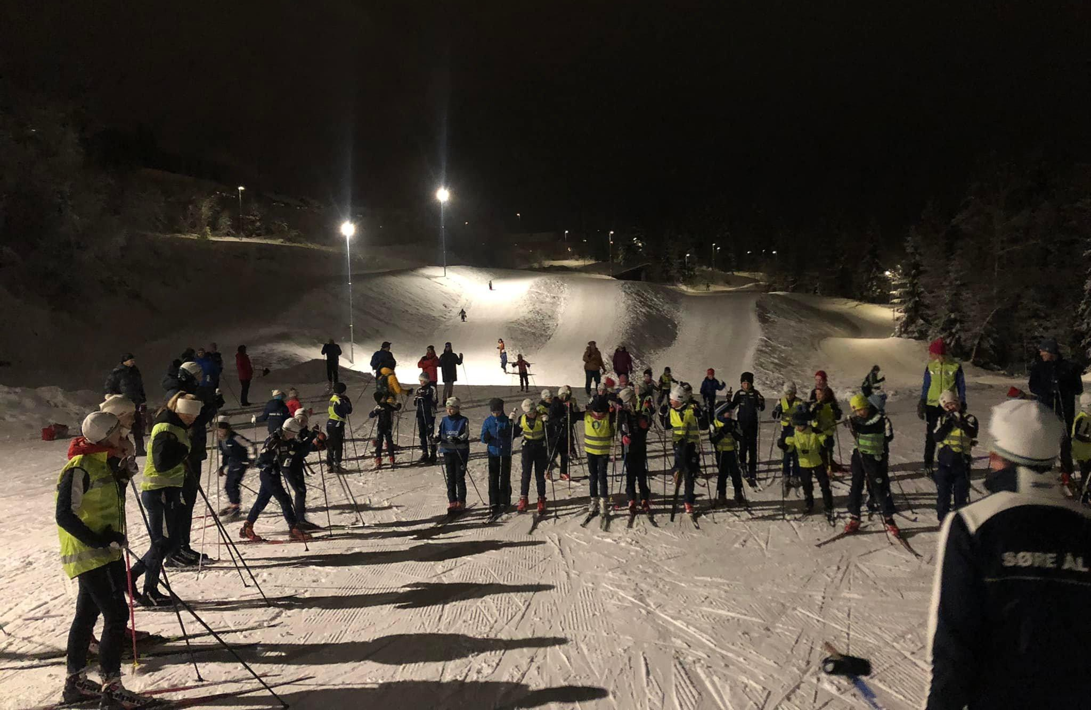
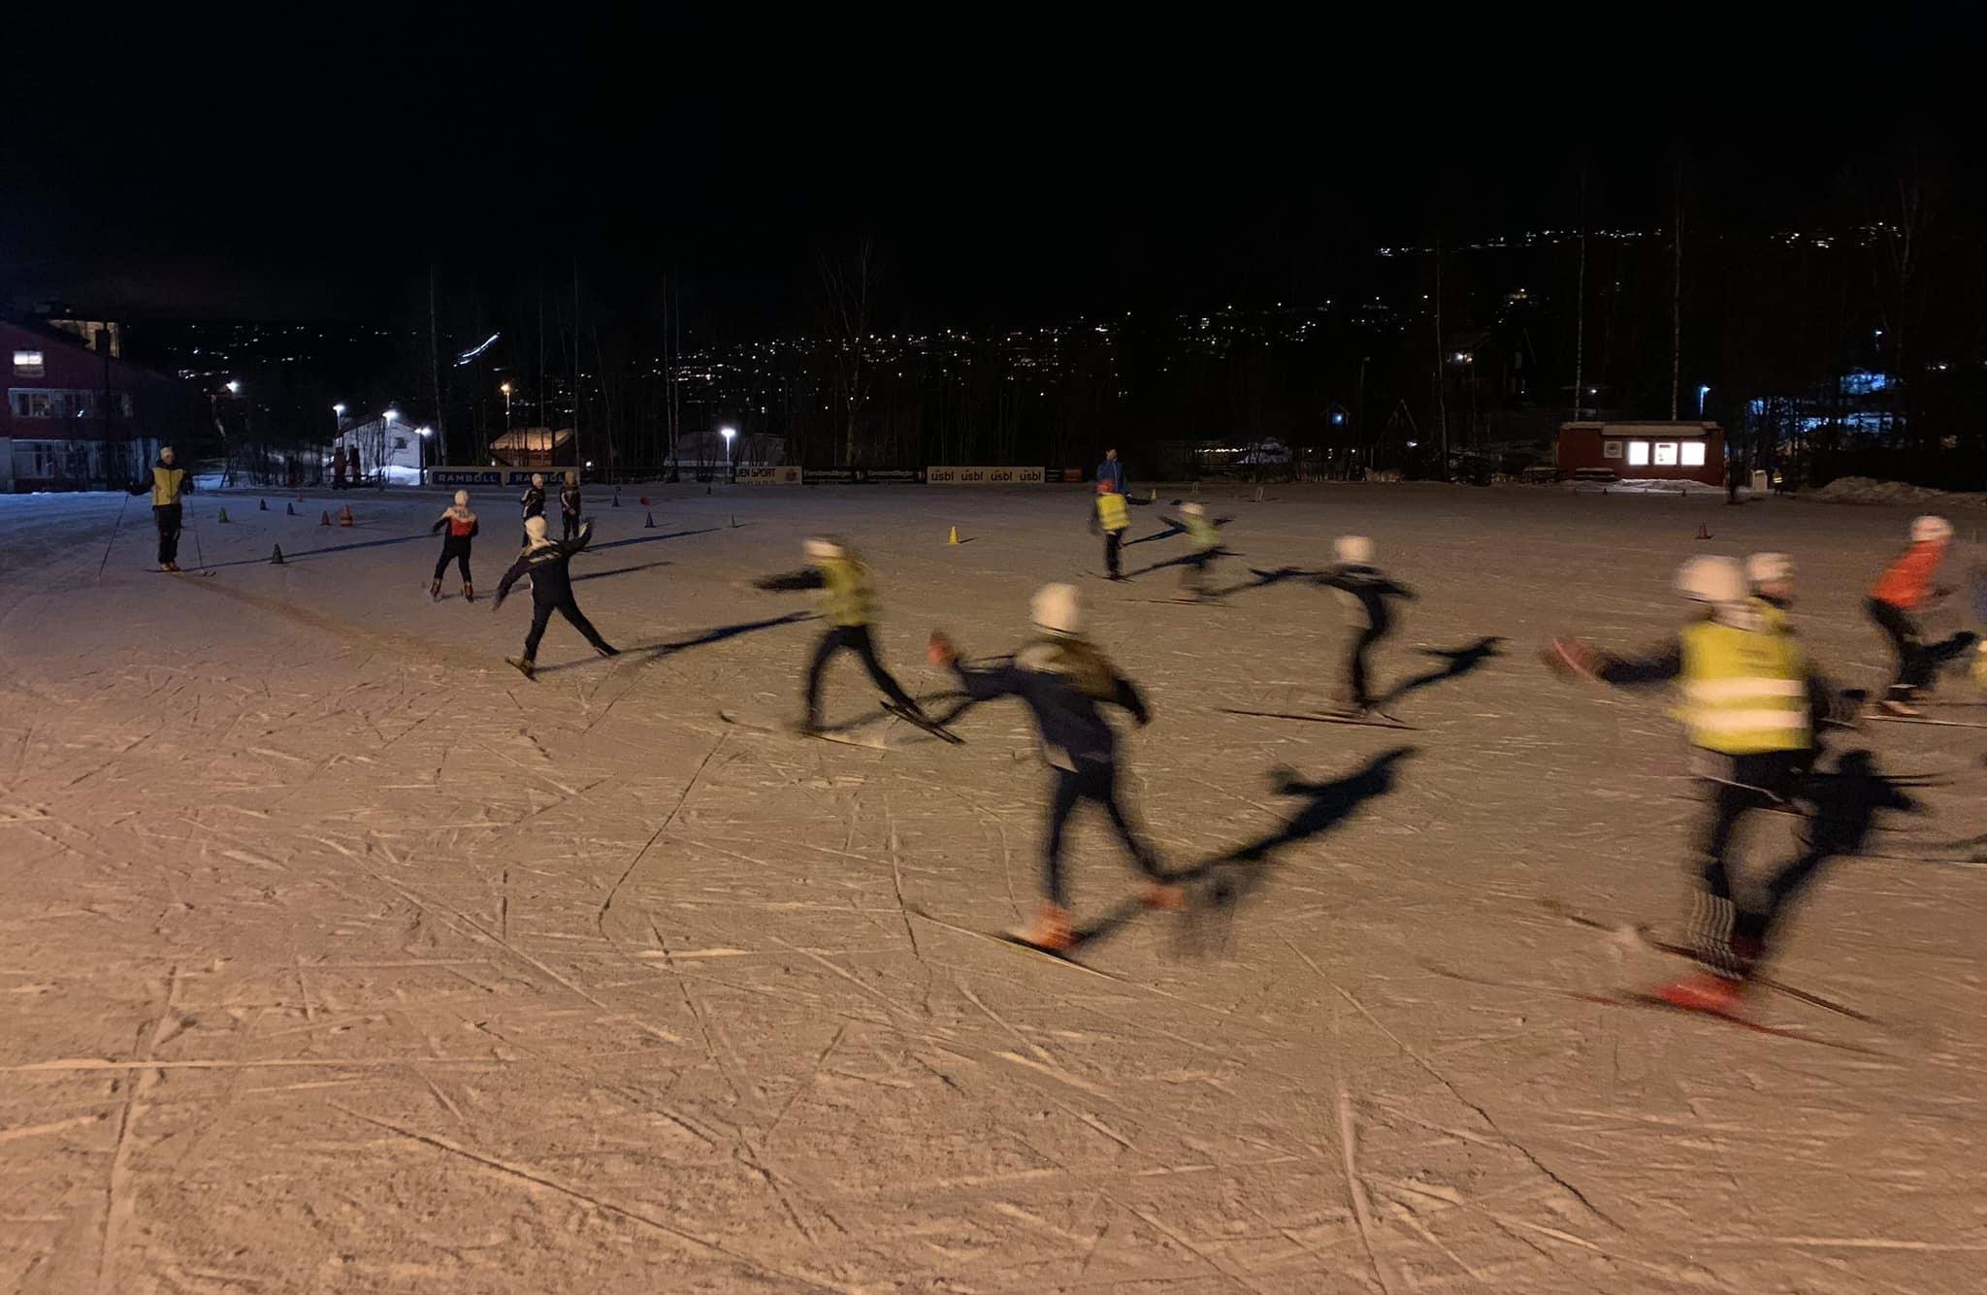
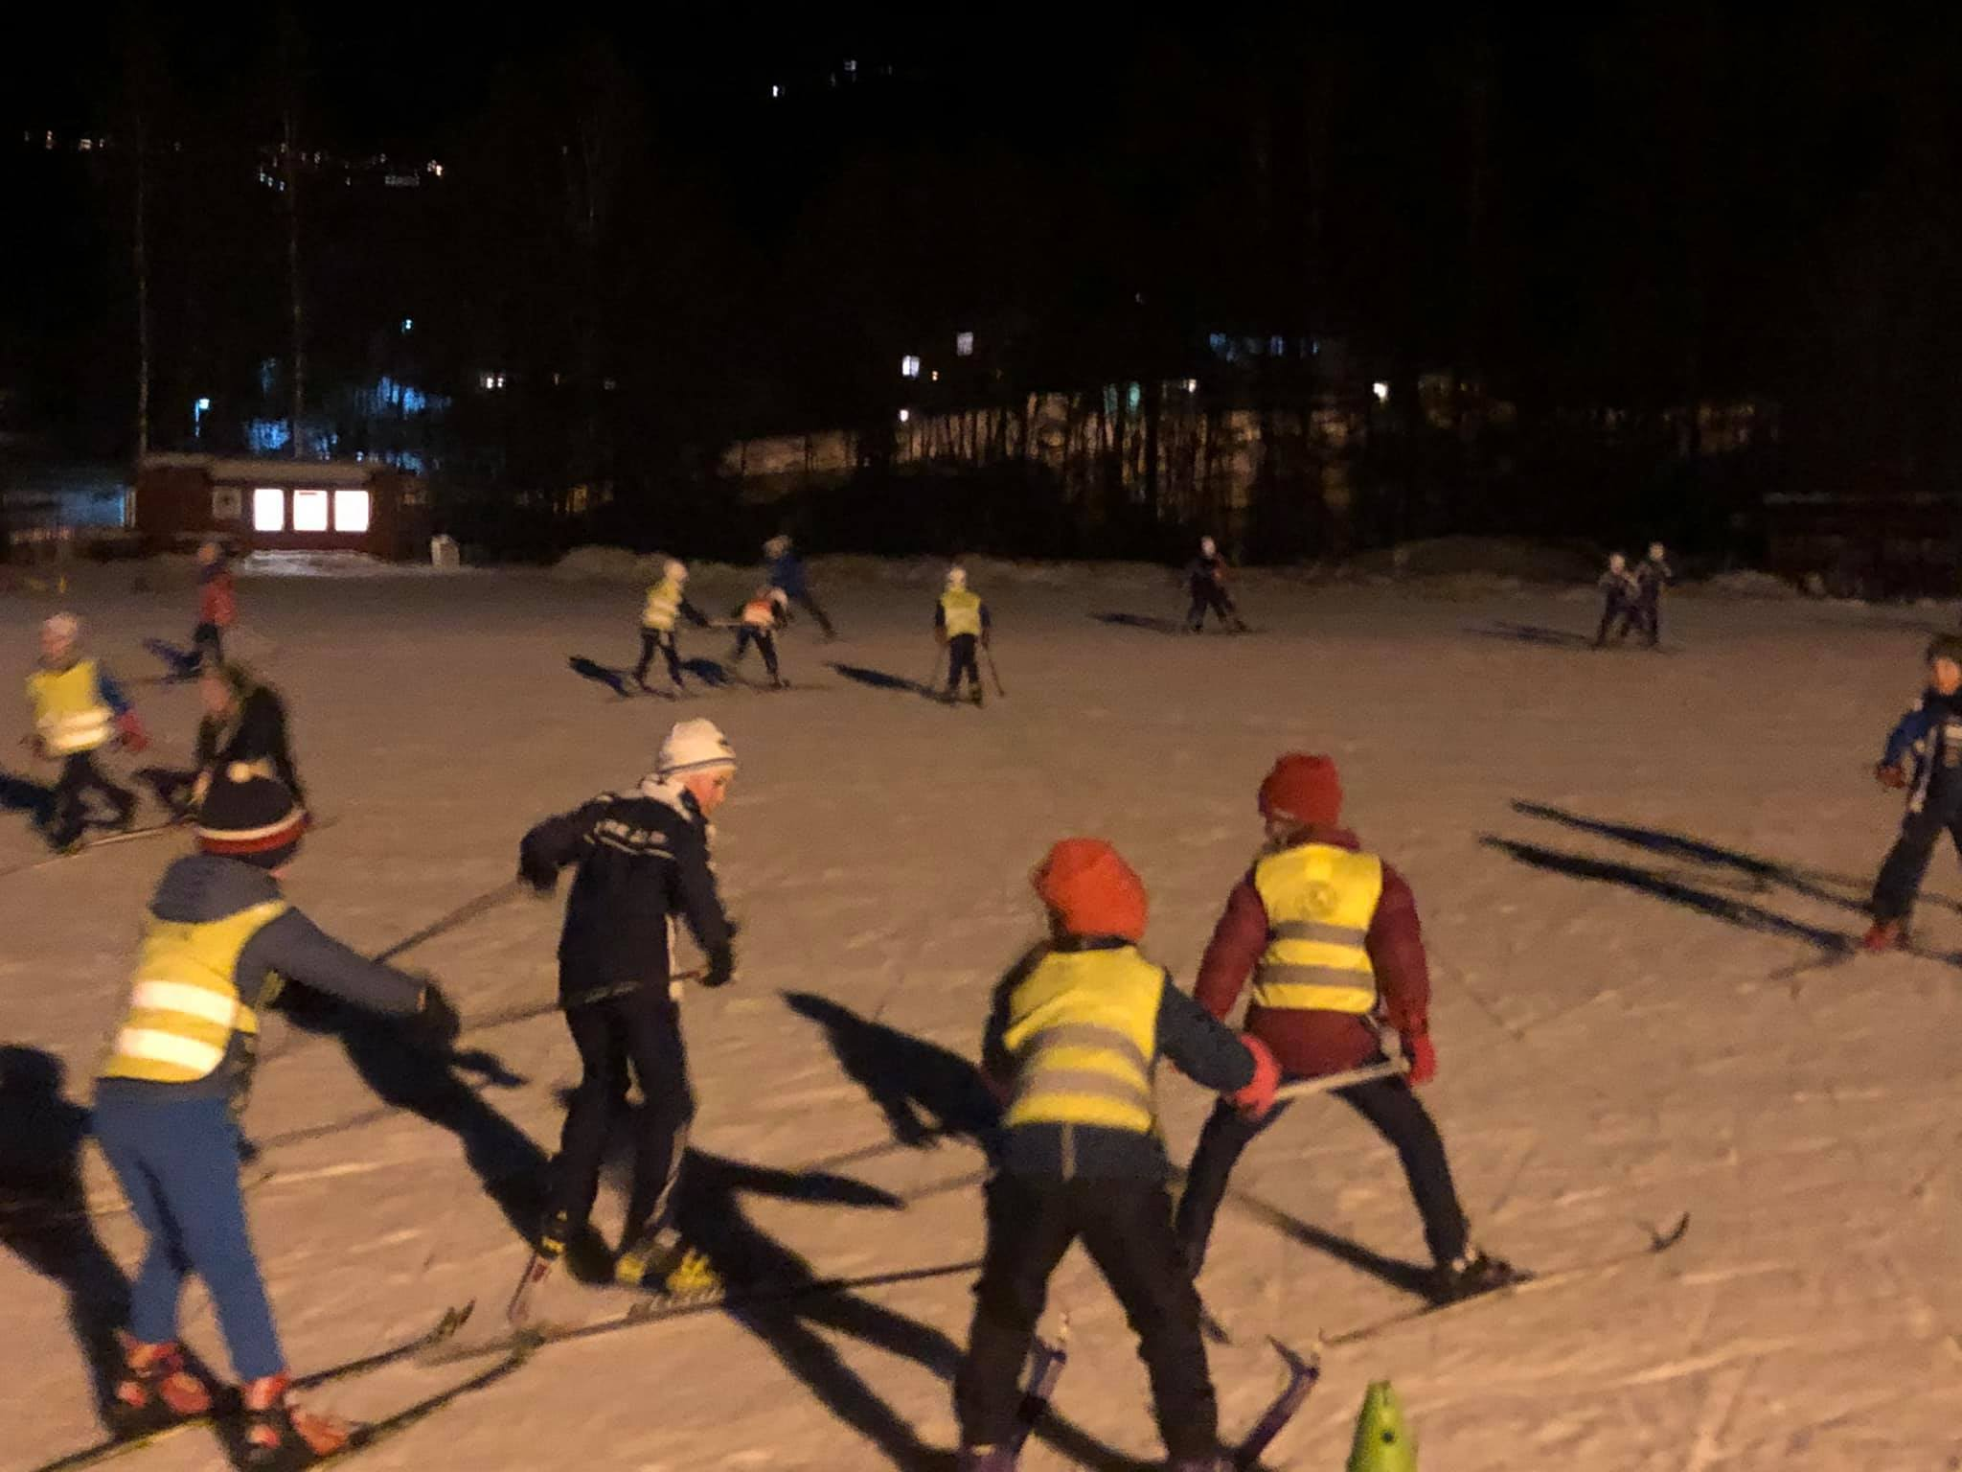
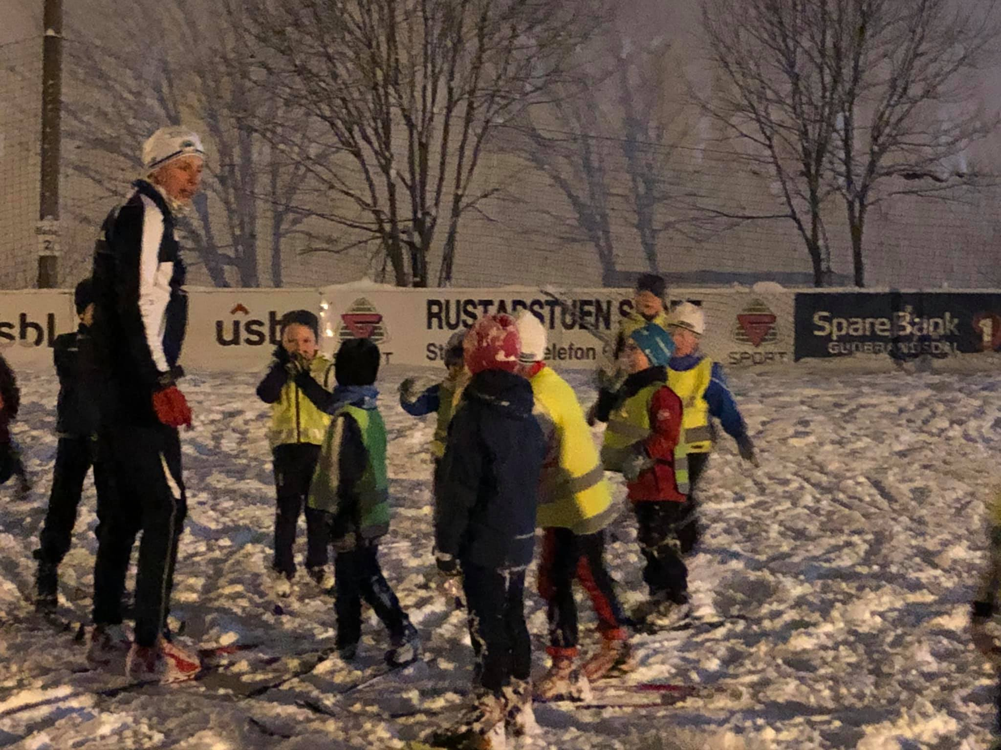
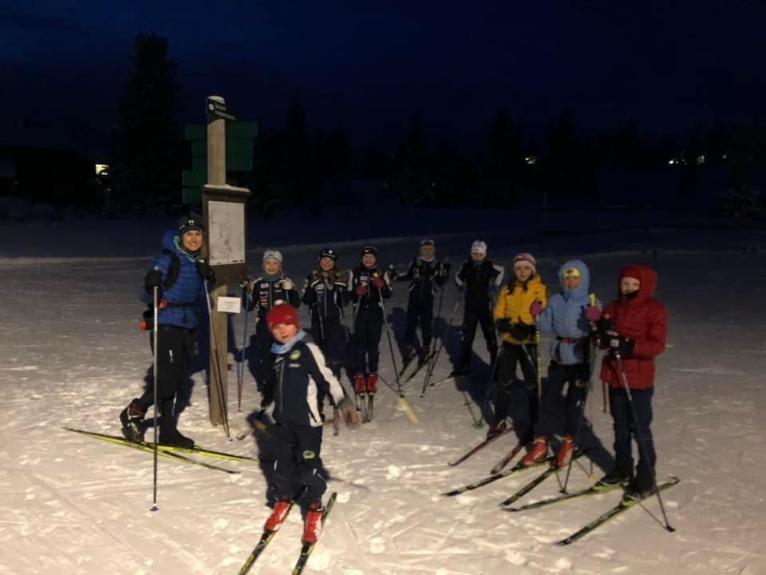

Slide 5
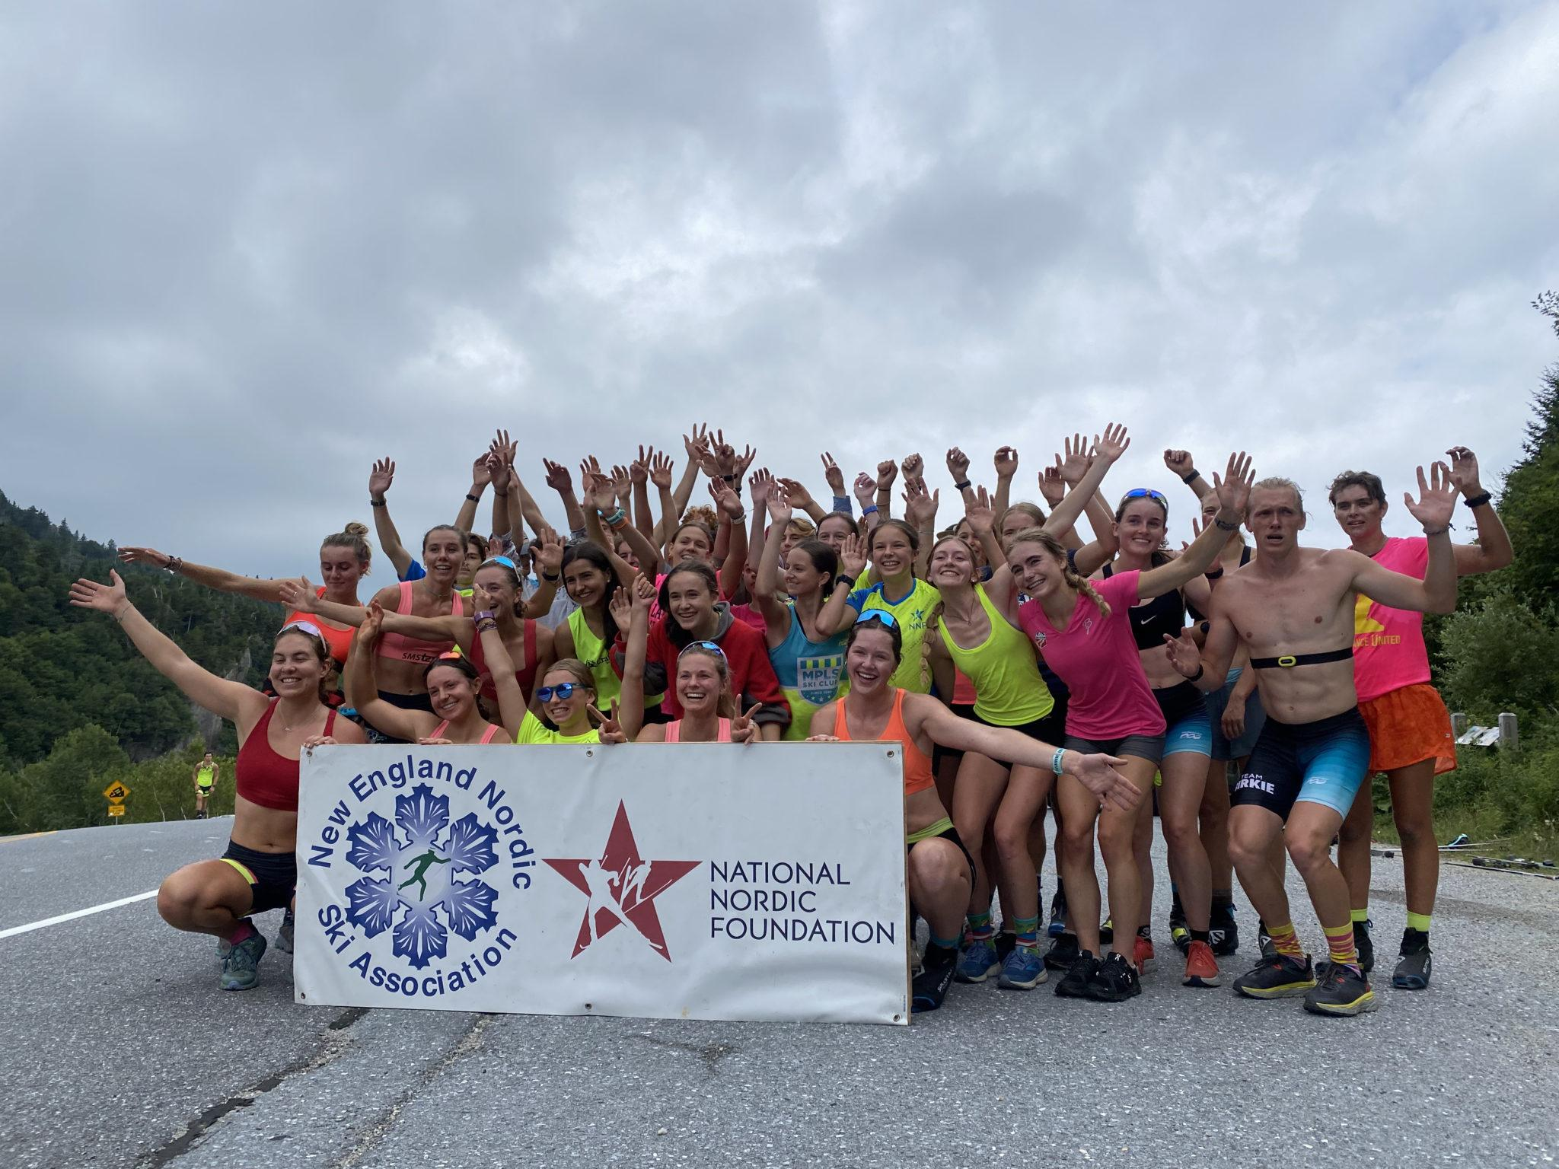
The New England Nordic Ski Association (NENSA) is the umbrella organization for Nordic skiing events in the region. We are a member-supported service organization that promotes the culture of cross-country skiing by creating opportunities for youth, athletes, coaches, officials and skiers of all levels. NENSA provides the support structure necessary to bring cross-country skiers to their highest potential at regional, national and international events.

Slide 6
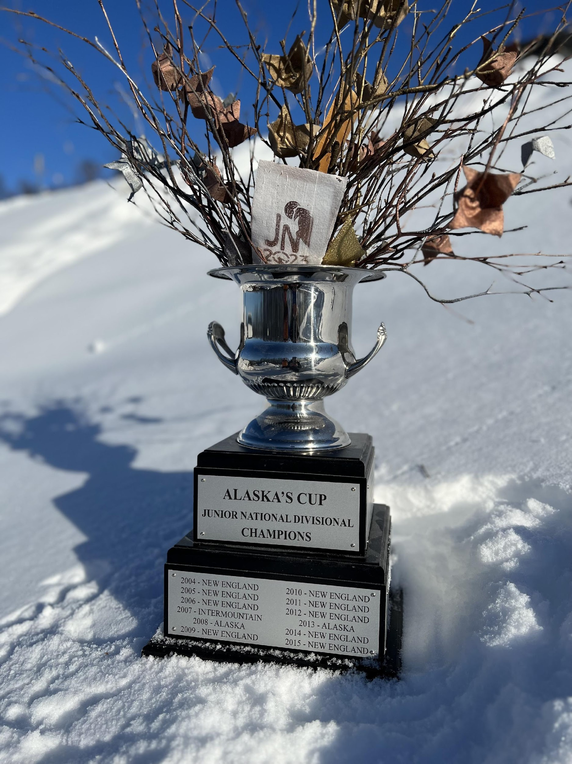
1986 Alaska 2005 New England
1987 New England 2006 New England
1988 Alaska 2007 Intermountain
1989 Alaska 2008 New England
1990 Alaska 2009 New England
1991 Alaska 2010 New England
1992 Alaska 2011 New England
1993 Alaska 2012 New England
1994 Alaska 2013 Alaska
1995 Alaska 2014 New England
1996 New England 2015 New England
1997 Midwest 2016 New England
1998 Intermountain 2017 New England
1999 Alaska 2018 New England
2000 Alaska 2019 New England
2001 Alaska 2020 Alaska*
2002 Alaska 2022 New England
2003 Alaska 2023 New England
2004 New England

Slide 7
Community Development: Clubs
Cultural Development: Lifestyle, Family
Bill Koch League

Slide 8
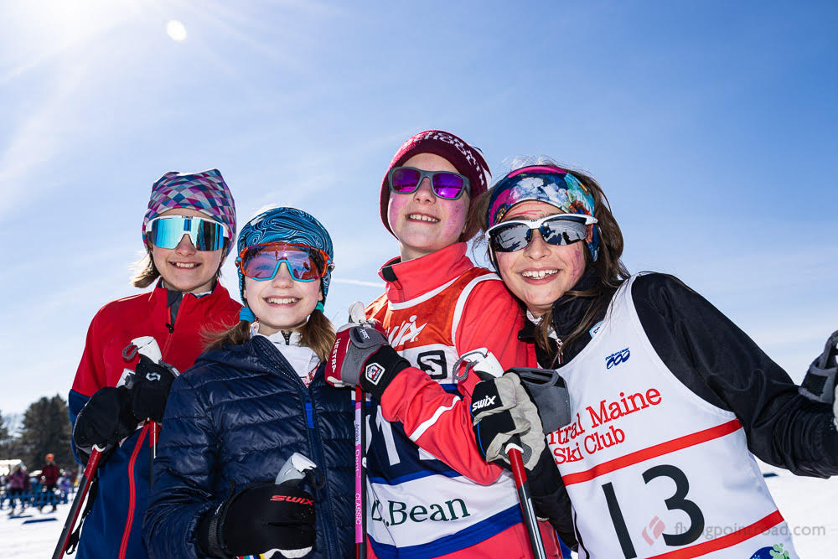
Our Mission
To share the joy of gliding on snow through educational, recreational, introductory and competitive programs to nurture and sustain an active cross country ski community for all ages and levels throughout the East.

Slide 9
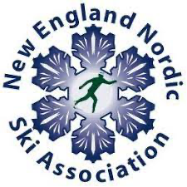
Youth and Introductory Programming
Bill Koch League
Nordic Rocks – an introductory ski program in schools
New England BKL Festival
Summer camp visits
Women’s Day and other introductory ski clinics
Community Events and Tours
Clinics with Youth Enrichment Services, WinterKids
Education
Coaches Education
Technical Delegate Education
Event Organizer Seminar
Club development and support
Venue consulting and support for races/events
Community newsletters
Racing
Eastern Cup racing
Popular/Community racing
U16 Championships
Eastern High School Championships
NENSA Elite & Development Teams
New England Junior National Team
US Ski & Snowboard Regional Elite Group Camp
NENSA Regional Development Group Camp
Rollerski clinics and race series

Slide 10
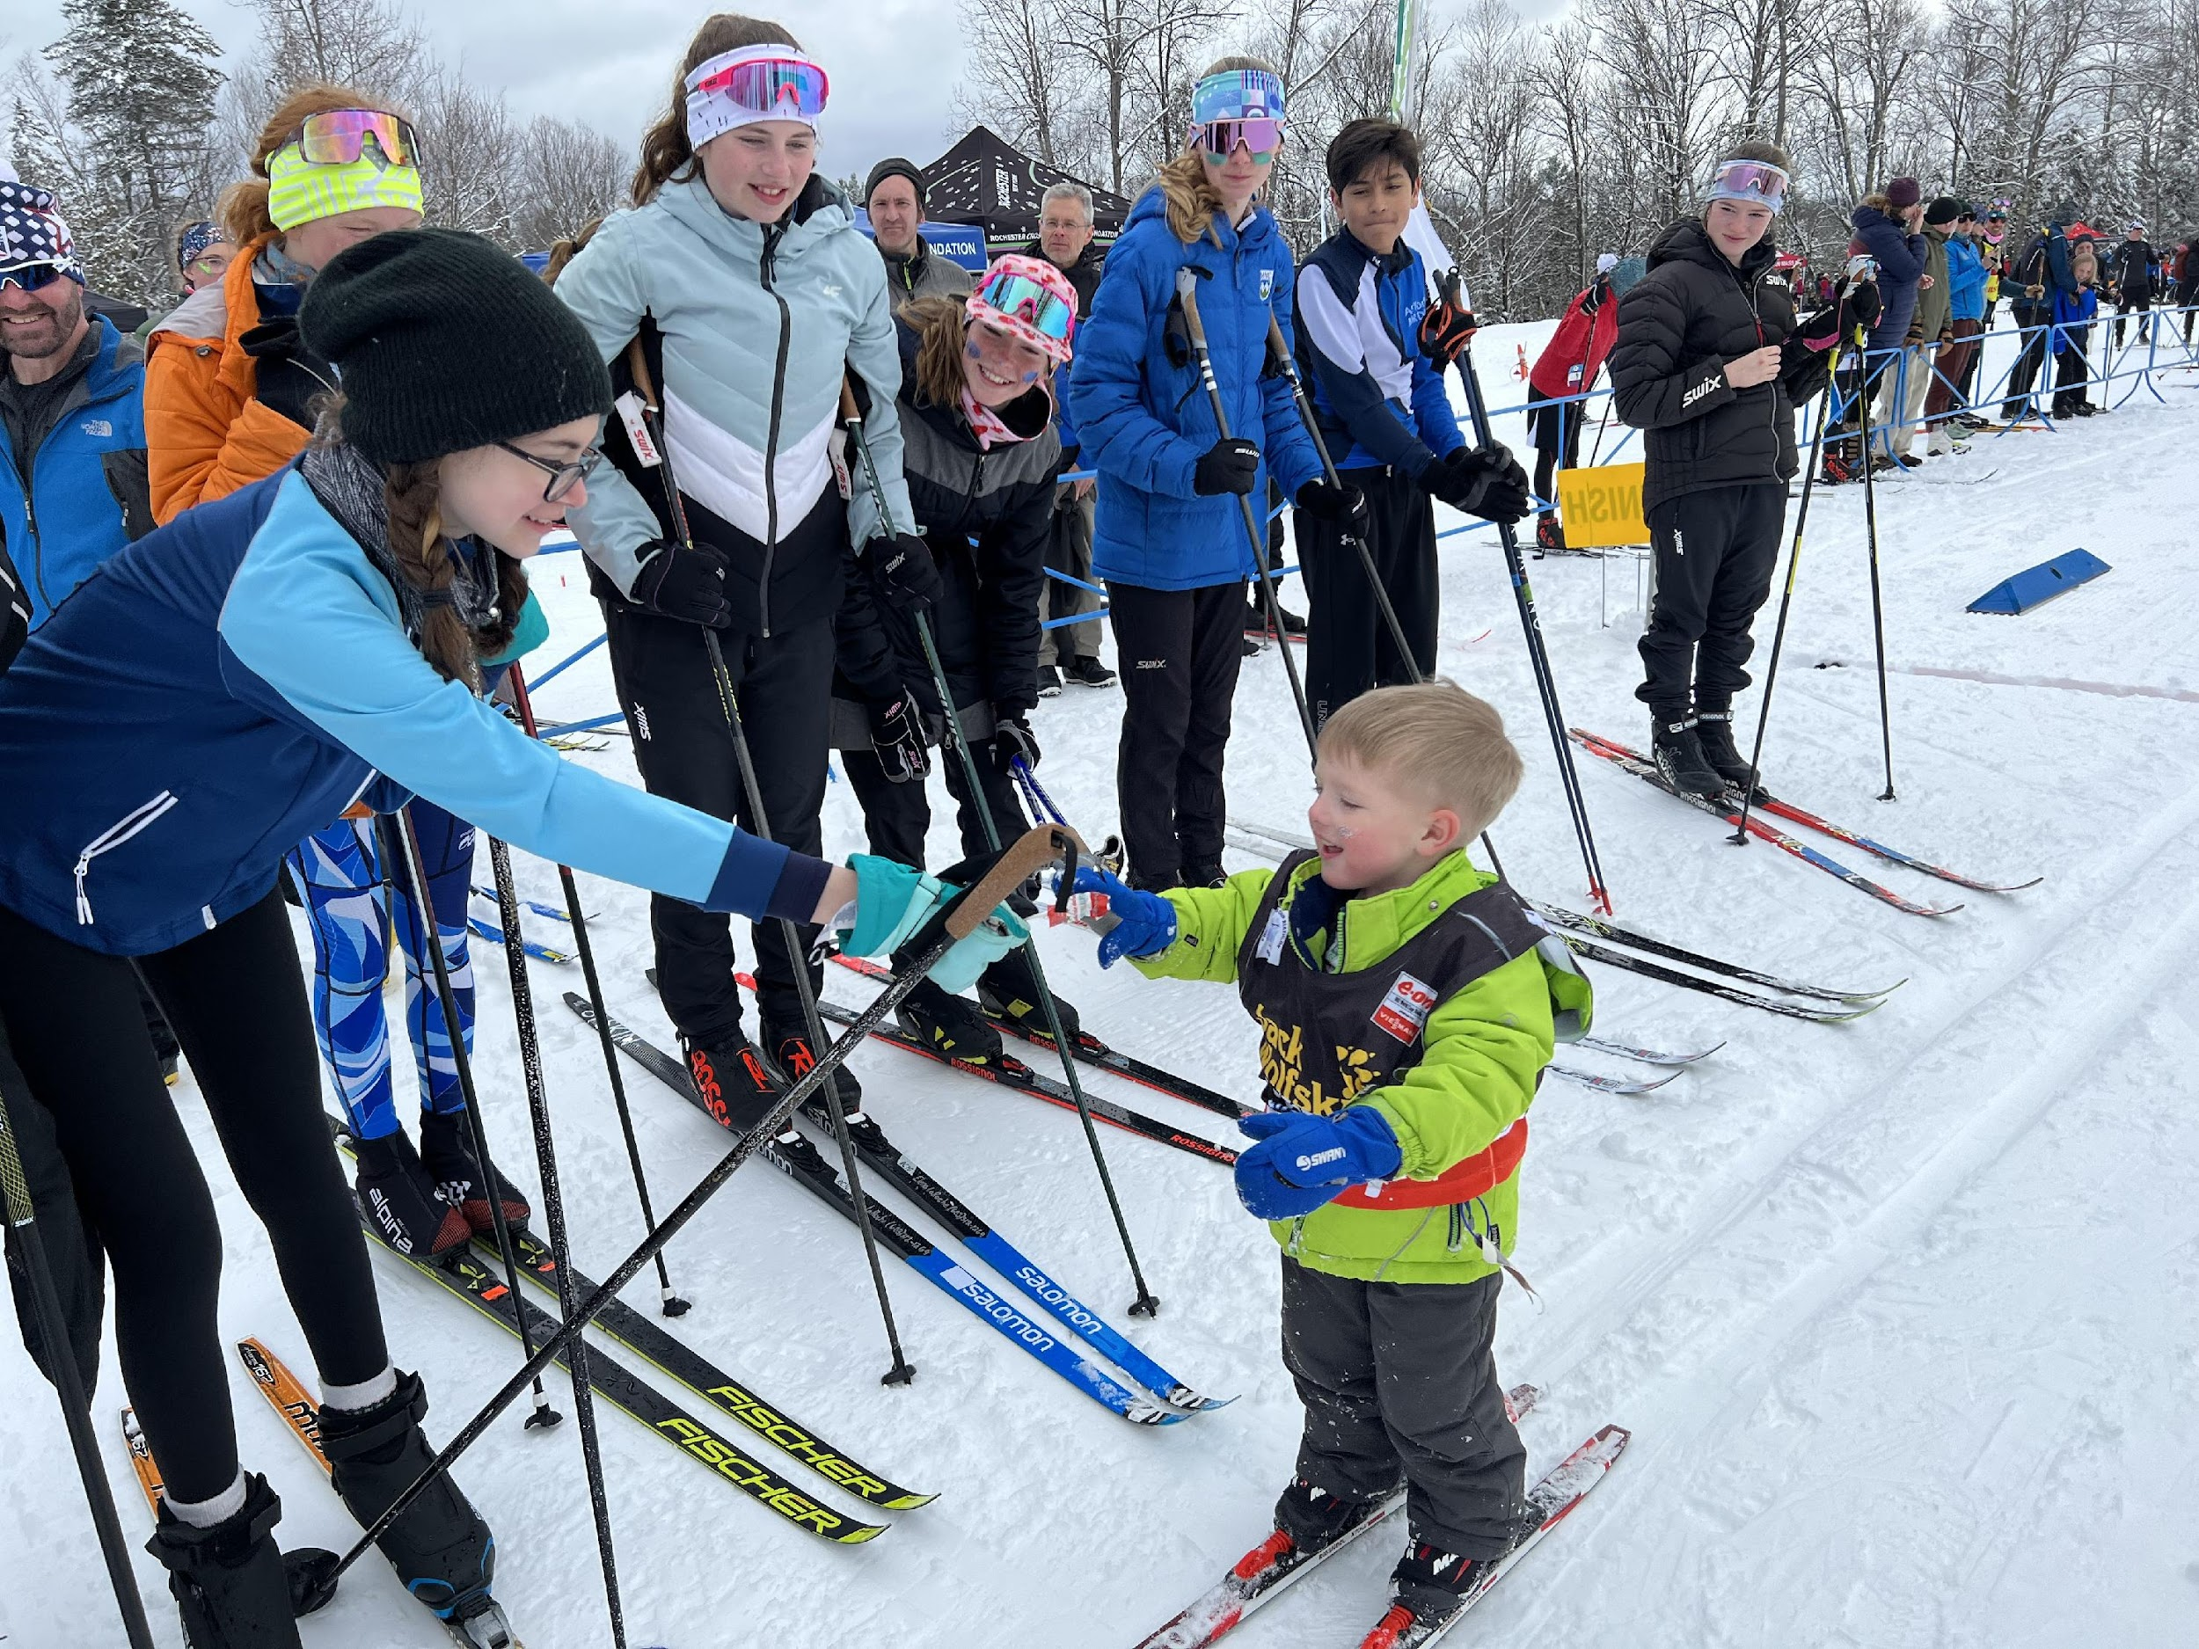
The Bill Koch Youth Ski League Teaching Philosophy
All Bill Koch Youth Ski League (BKL) activities and competitions are designed to teach young people to participate to the best of their respective abilities. The foundation of the BKL is centered on the belief that having fun is at the core of learning to cross-country ski and that children can develop physically, psychologically, and socially in a safe, healthy, respectful, inclusive, and supportive environment.

Slide 11
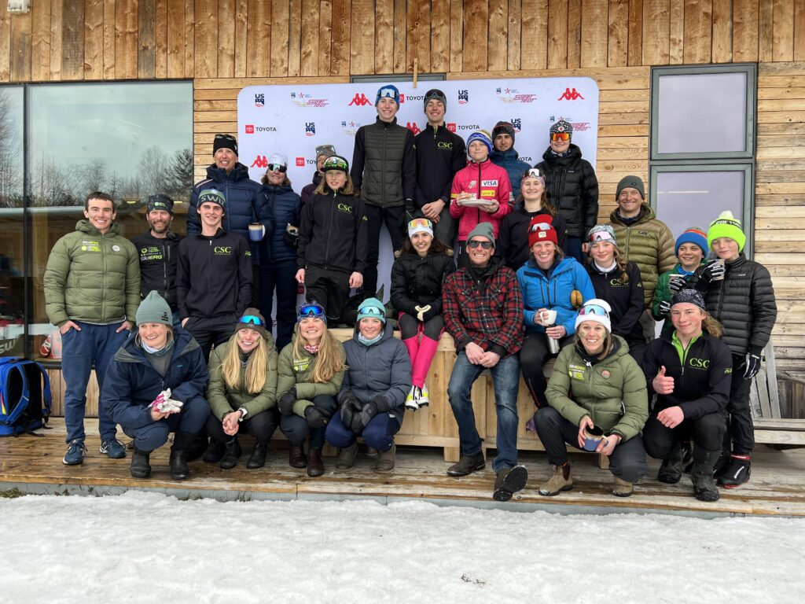
Club Development
Community building
Activity
Presence
Family participation
Social opportunities
Programming
Volunteerism
Mentorship
Cultural development of sport
Events
Health and lifestyle
Environmental stewardship
Leadership
NENSA Club Directory

Slide 12
Events

Slide 13
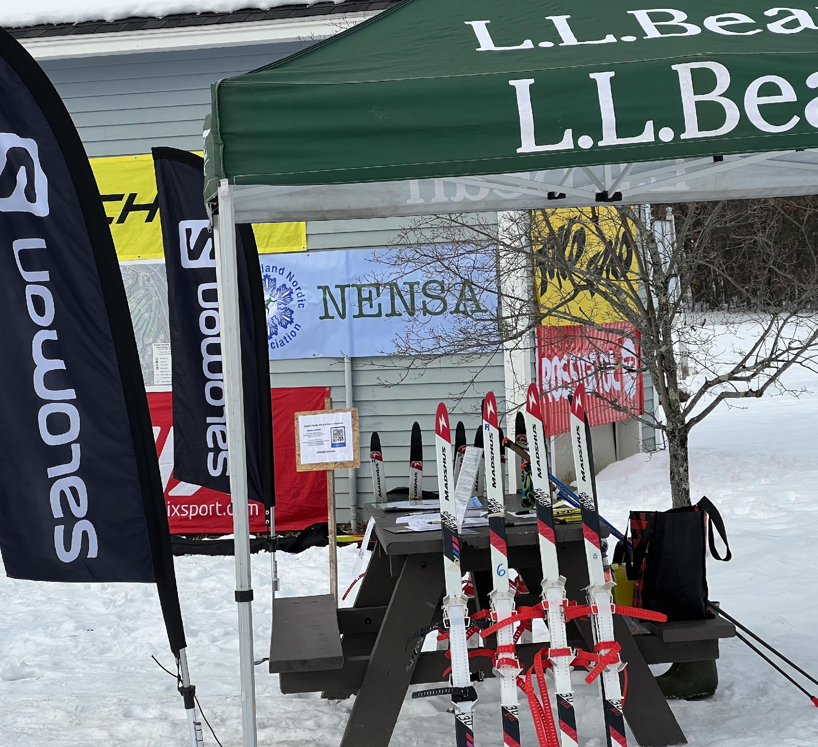
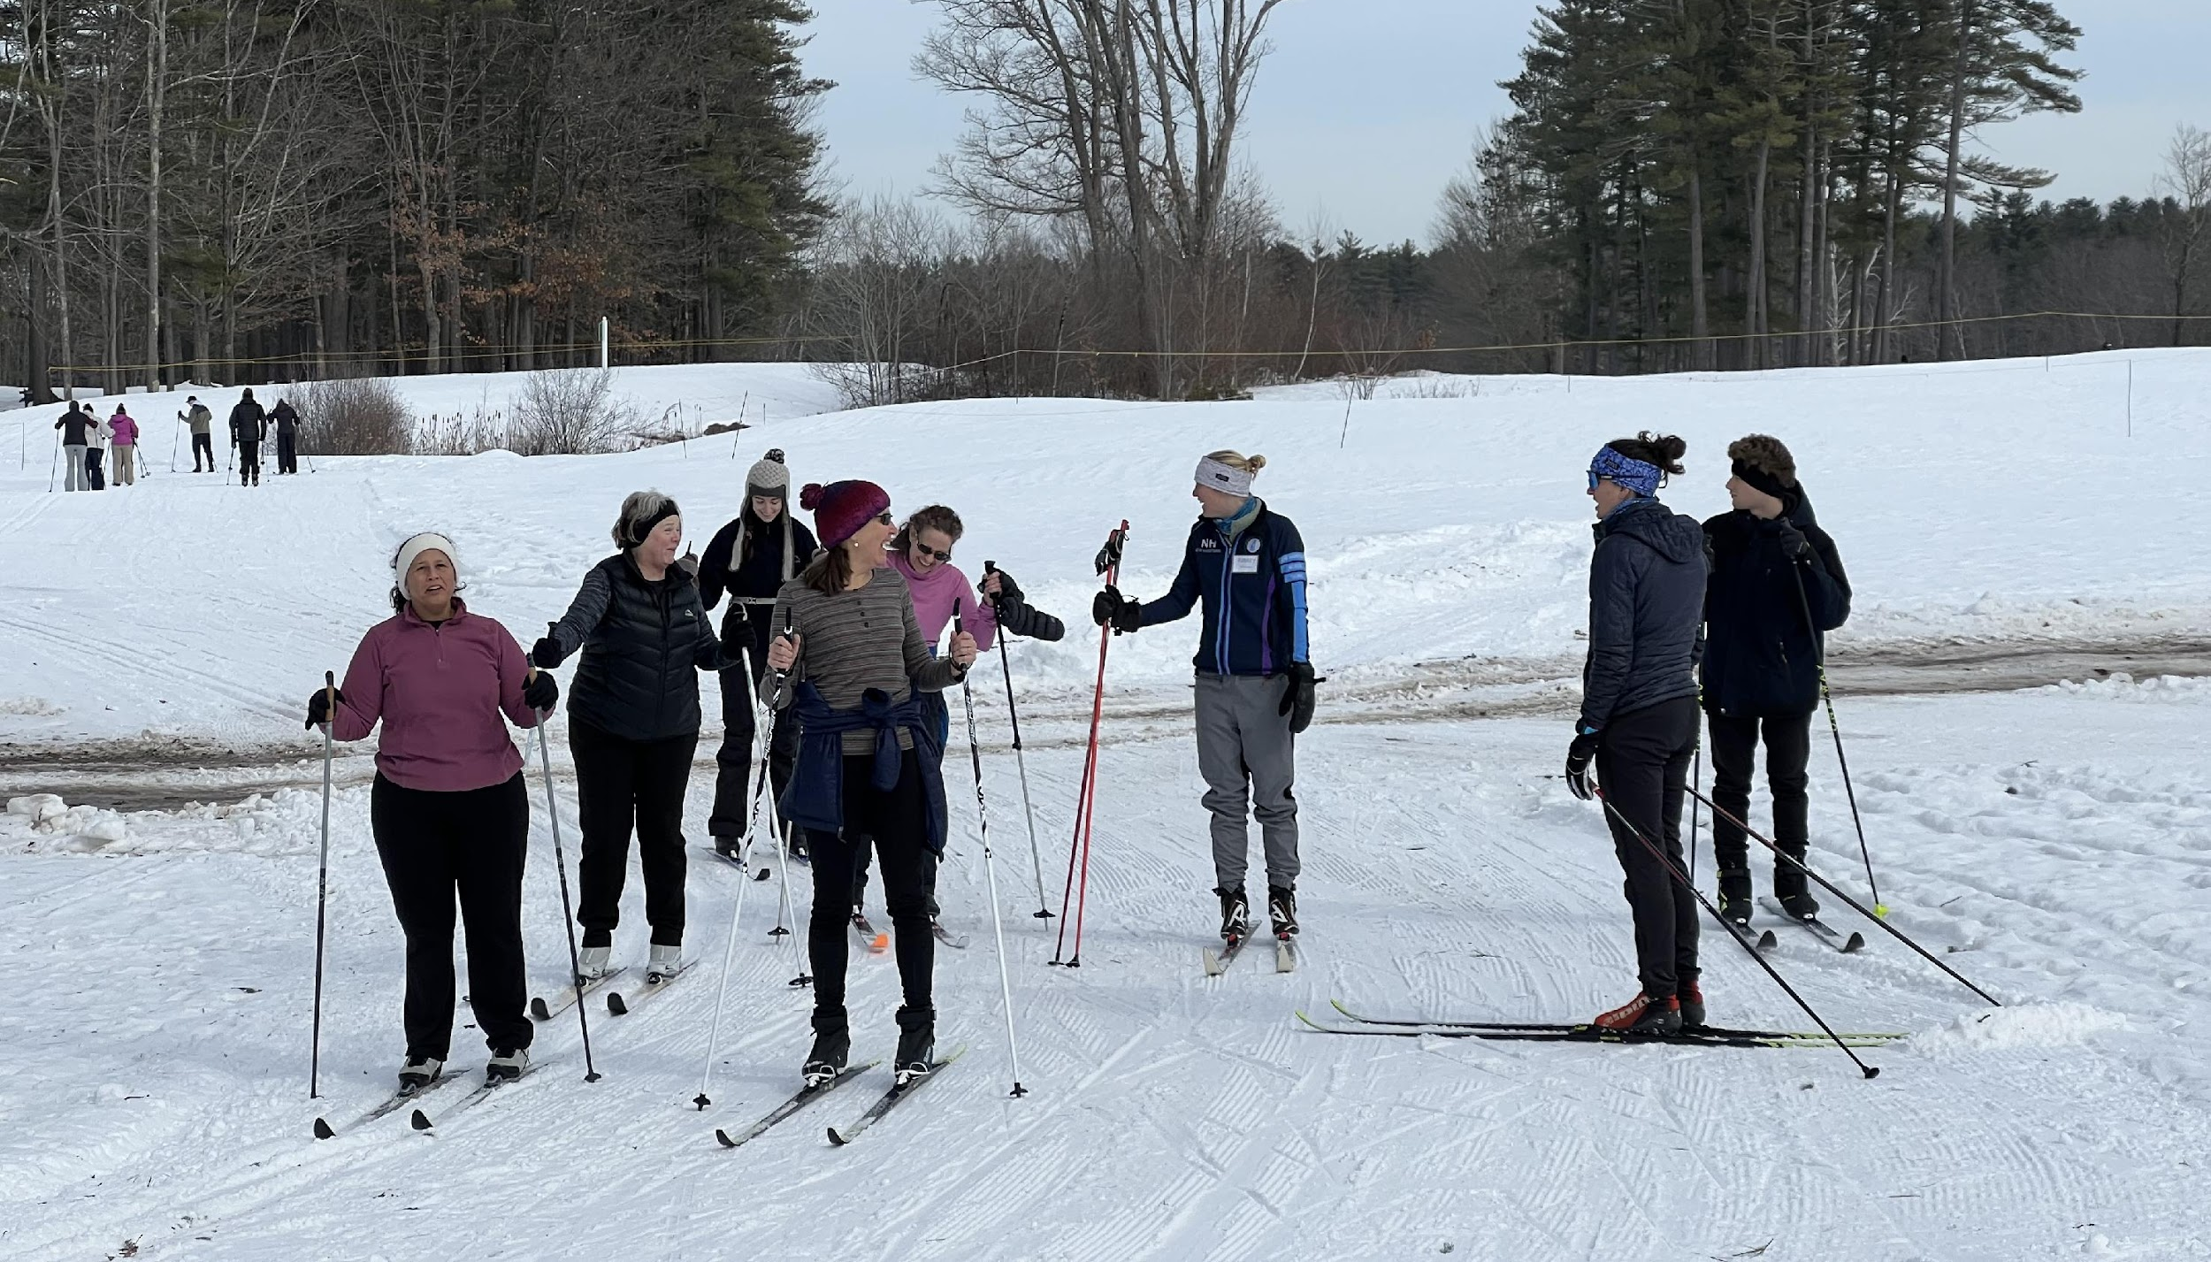

Slide 14
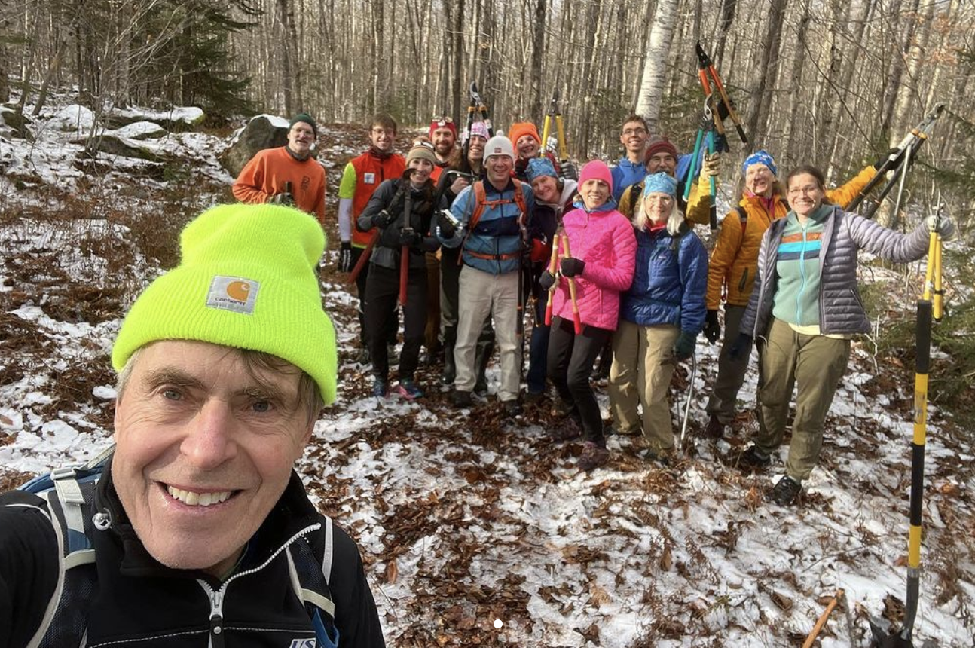
Volunteer Activation

Slide 15
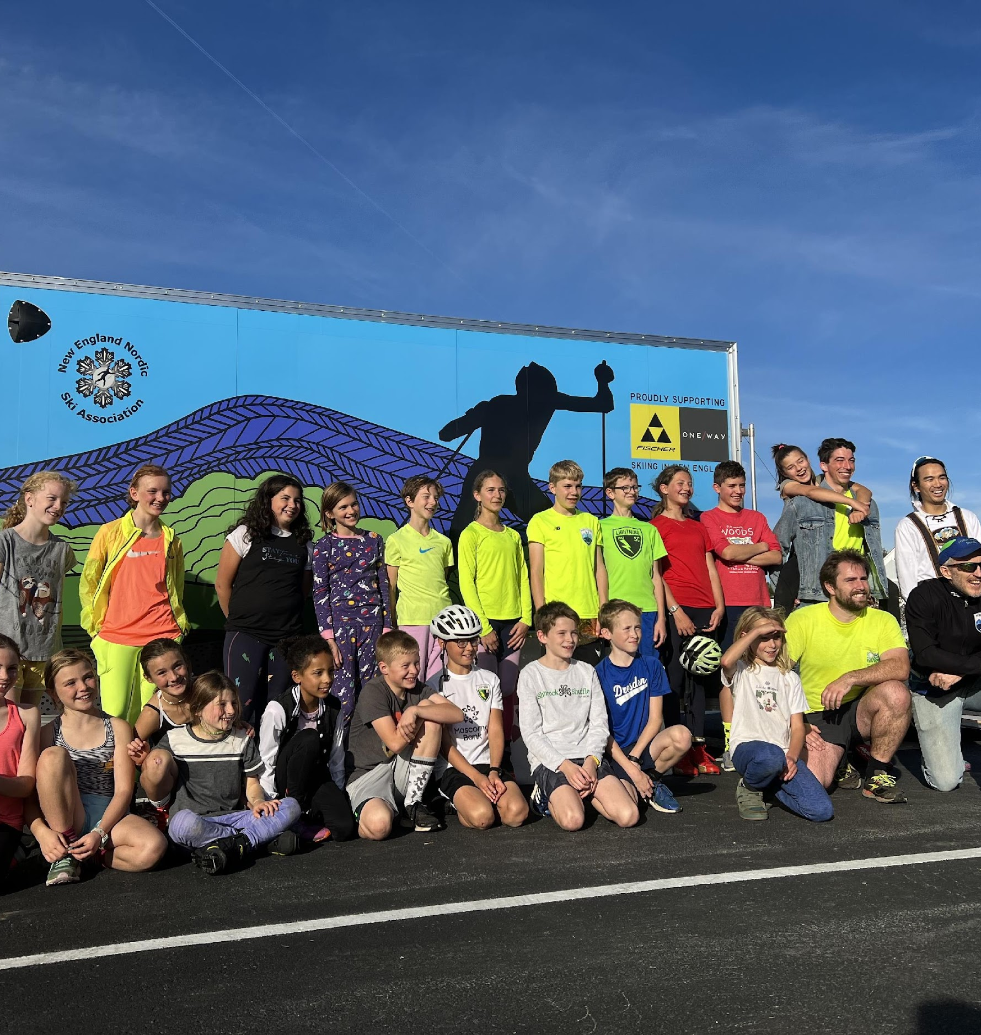
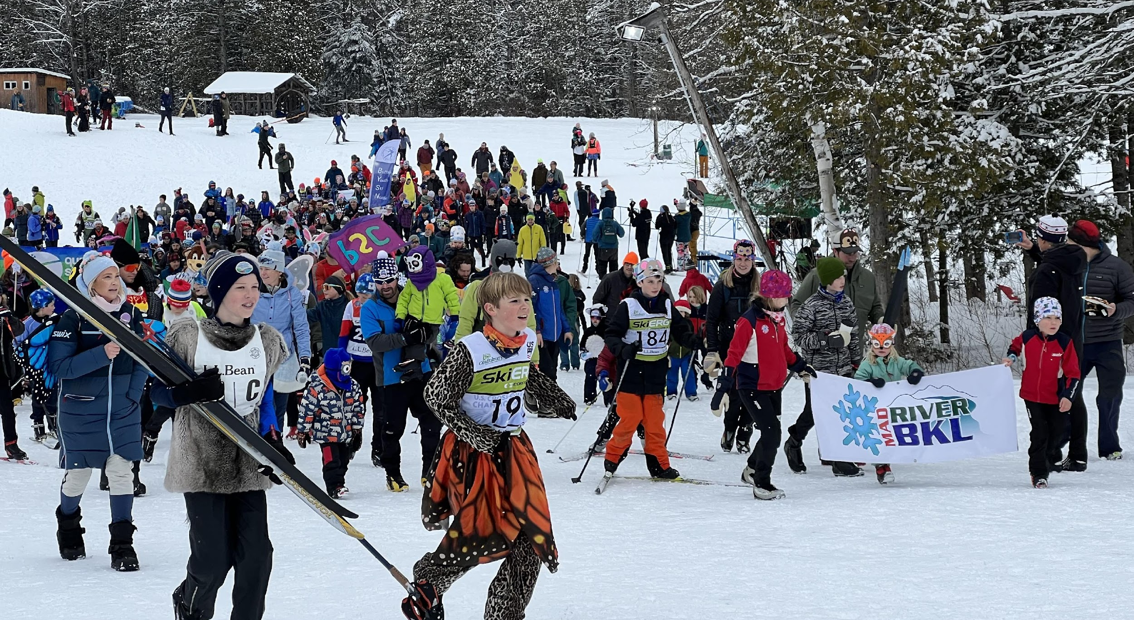
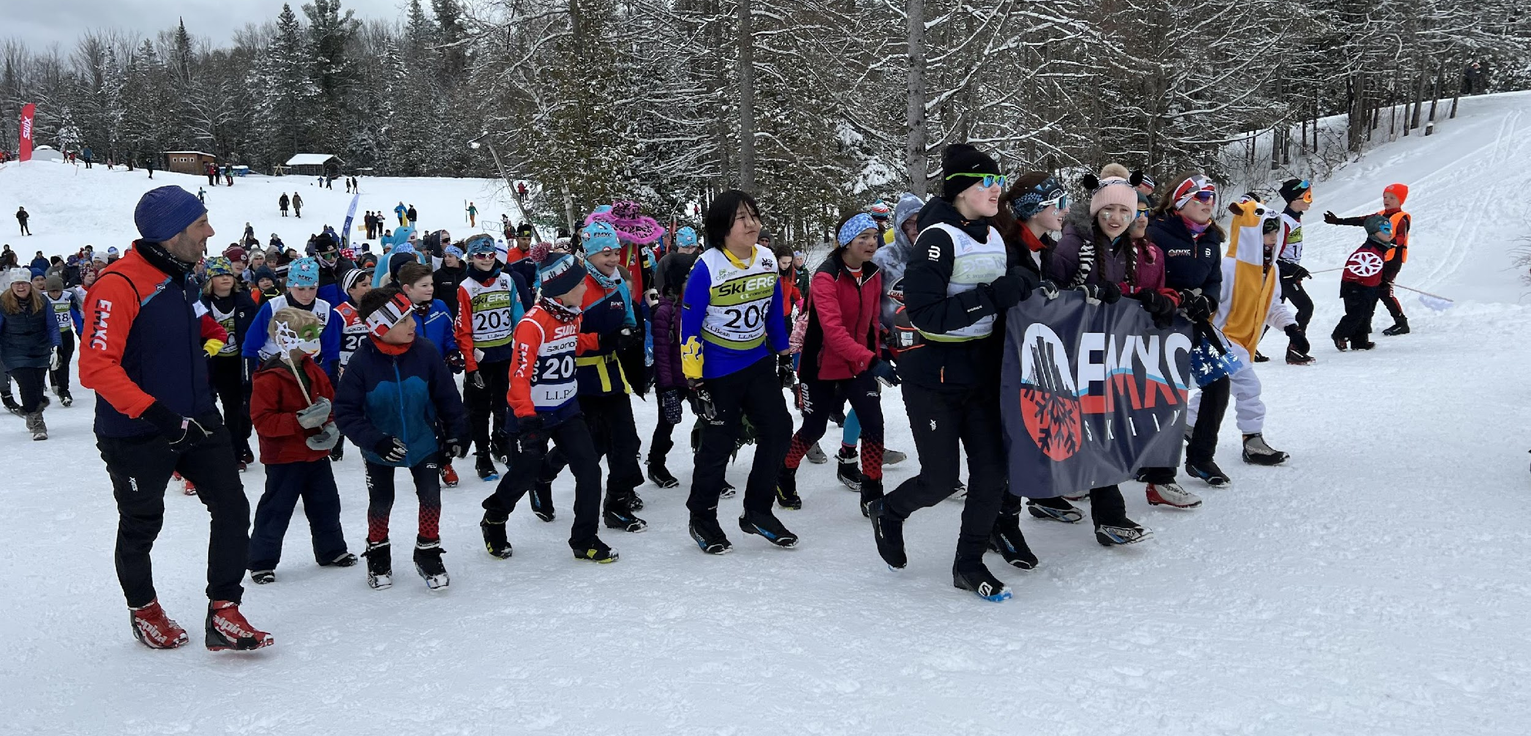

Slide 16
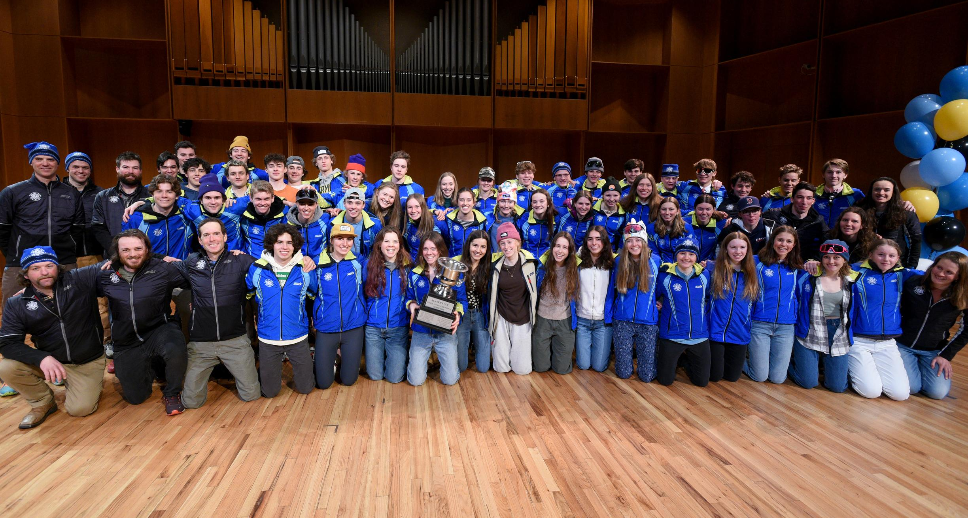
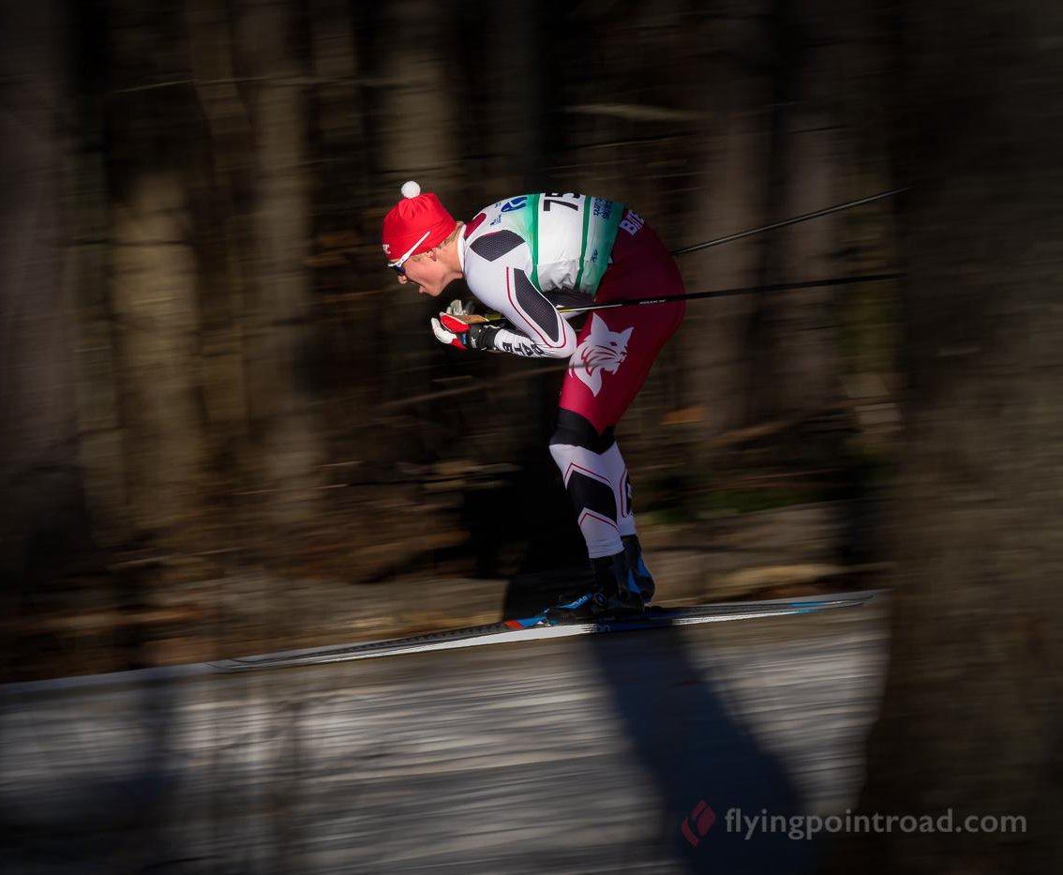
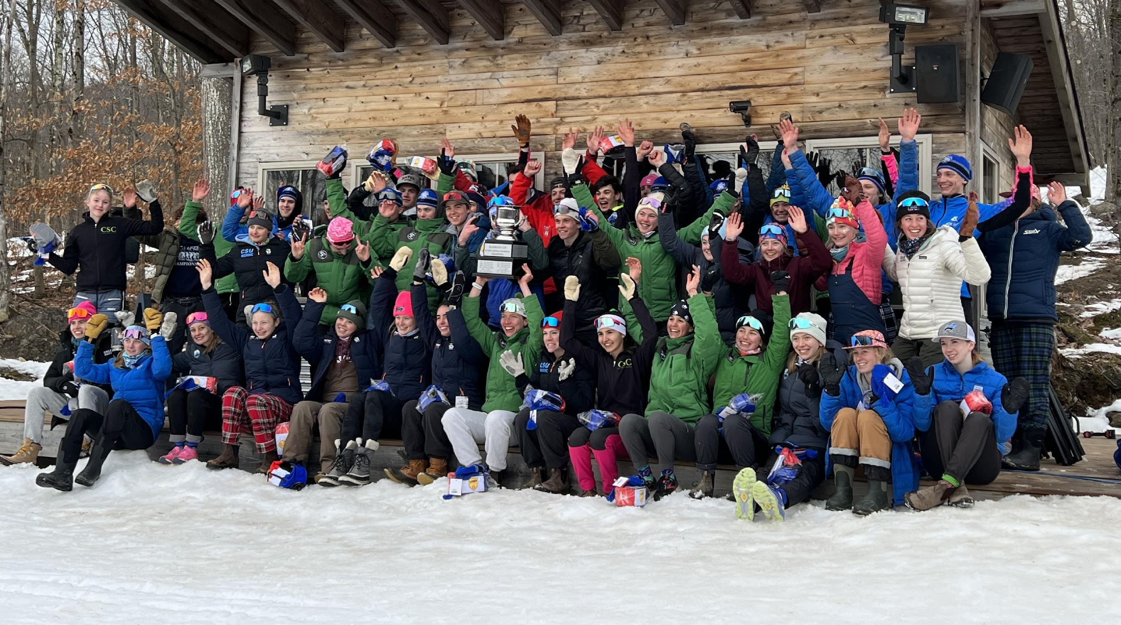

Slide 18
The Nordic Rocks program is generously funded by the Share Winter Foundation and the Killington World Cup Foundation and was developed to introduce children in grades K-6 to the excitement of cross country skiing. Nordic Rocks provides elementary school students with an opportunity to experience cross country skiing during the school day with their teachers and classmates, and to learn the health and lifestyle benefits associated with exercise and outdoor fun. The overarching goal of this program is to provide all children with the opportunity to ski as well as grow and develop life skills through sport.

Slide 19
NENSA assists participating Nordic Rocks schools with:
equipment acquisition
teaching support
a regularly updated 5-lesson curriculum
access to instructional videos
a games list
optional NENSA staff program visit

Slide 20
We have programs in schools in Vermont, New Hampshire, Maine, Massachusetts and New York.
Of the 2,167 participants from last winter:
1,118 (51%) had never been on skis before
11% Global Majority and Indigenous
40% qualified for free and reduced lunch.
6,362
STUDENTS IN 53 SCHOOLS

Slide 21
“Most of our students had never experienced cross country skiing and many had never been on skis before this program. As a K-12 school, we were able to coordinate with our high school team that volunteered to assist with our classes in Physical Education. They inspired a new generation of nordic skiers. We also have outdoor time for our students on our early release days and have been able to provide the choice to ski during that time.”

Slide 22
“My joy today was trying skiing and my goal is to try skiing hills next time.”
“I want to be a world champion skier!”

Slide 23
The Nordic Rocks equipment consists of Madshus skis with Lost Nation R&D snowboot bindings that adjust to fit any boot size.
“Our students…are loving their cross country experience on the Nordic Rock skis. The bindings are easy to adjust and strap onto the child with one quick tug. Unlike the old system, these bindings are stable and so user friendly. The skis, themselves, are great and so adaptable to every kind of snow. What a wonderful addition and opportunity the Nordic Rocks program has provided to our students. Skiing in school, for many of our students, is the only opportunity that they will ever have to try cross country skiing. It’s been a raving success! Thanks so much! The Nordic Rock skis are amazing!”

Slide 24
South/Central NH
Kearsarge Elementary
Dublin Consolidated
Mountain Village Charter
Swasey Central
Newington Public
Mount Lebanon Elementary
Maine
Old Town Elementary
Gerald E. Talbot Community
New Suncook Elementary
Zippel Elementary
Pine Street
Presque Isle Middle
Easton Elementary
Northern NH
Woodland Community
Edward Fenn Elementary
Lancaster Elementary
Southern VT
Long Trail School
Flood Brook Elementary
Shaftsbury Elementary
The Mountain School at Winhall
Monument Elementary
Stamford Elementary
Putney Elementary
Northwest VT
Bellows Free Academy
Boys and Girls Club of Burlington
Fairfield Elementary
Georgia School
St. Albans Town Education Center
Central VT
Union Street School
Mount Holly School
Northeast Primary School
Northwest Primary School
Northeast VT
Craftsbury Elementary
Wolcott Elementary
Morristown Elementary
Derby Elementary
Eden Central School
Rumney Memorial School
Doty Memorial School
Newport Town School
Lowell Graded School
New York
Lake Placid Central
Gorham Intermediate
Platekill Elementary
Western MA
Amherst Montessori
Leverett Elementary
Fort River Elementary
Swift River Elementary
Emma L. Miller Memorial

